Slide 1
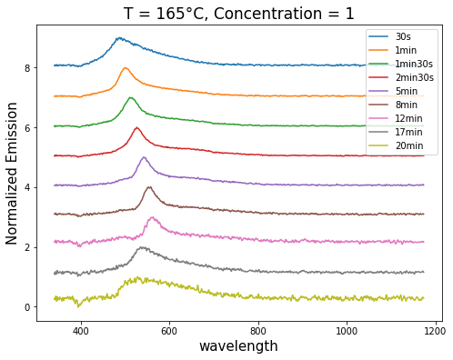
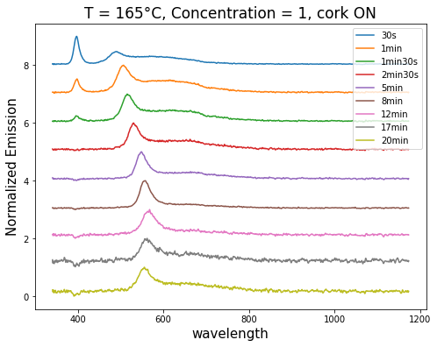
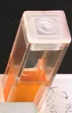
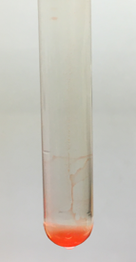
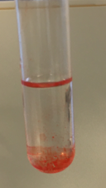
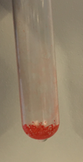
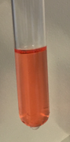
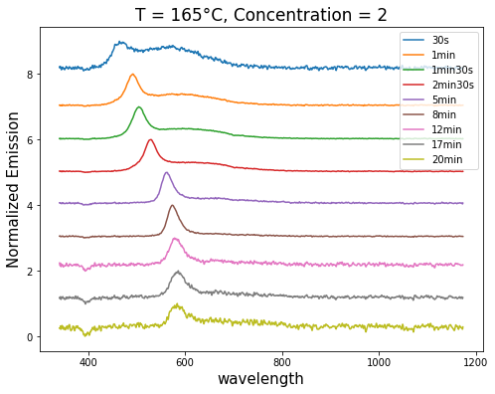
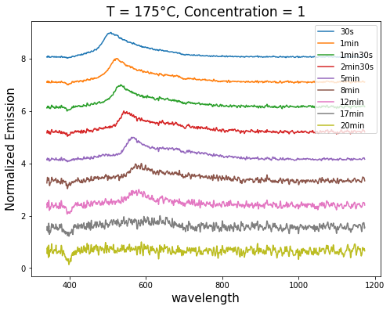
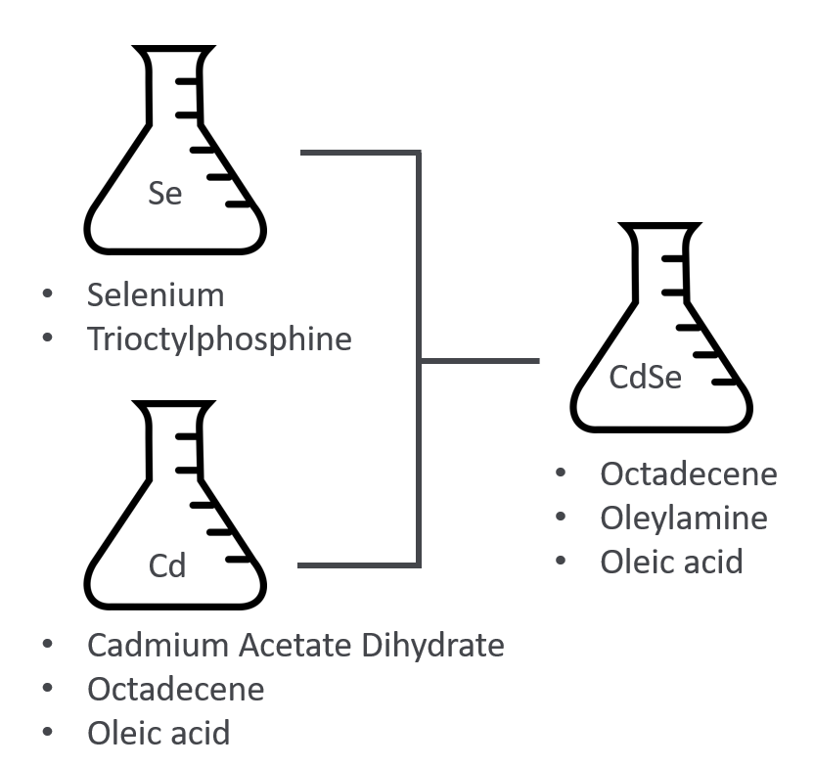
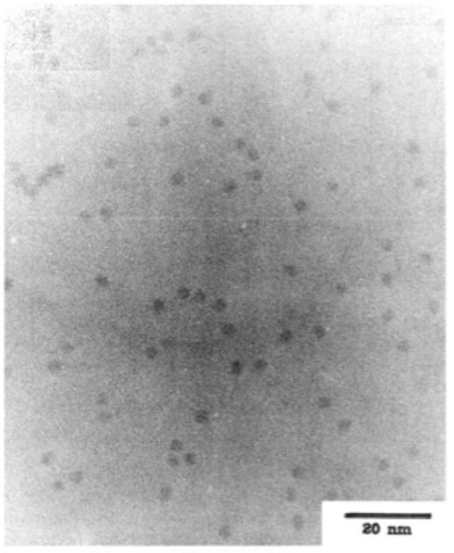
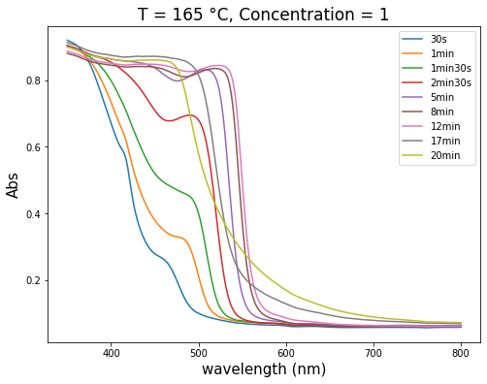
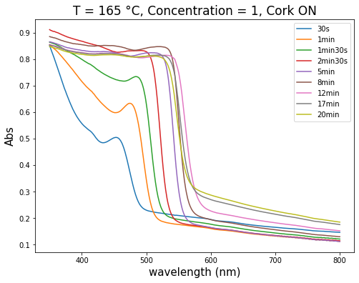
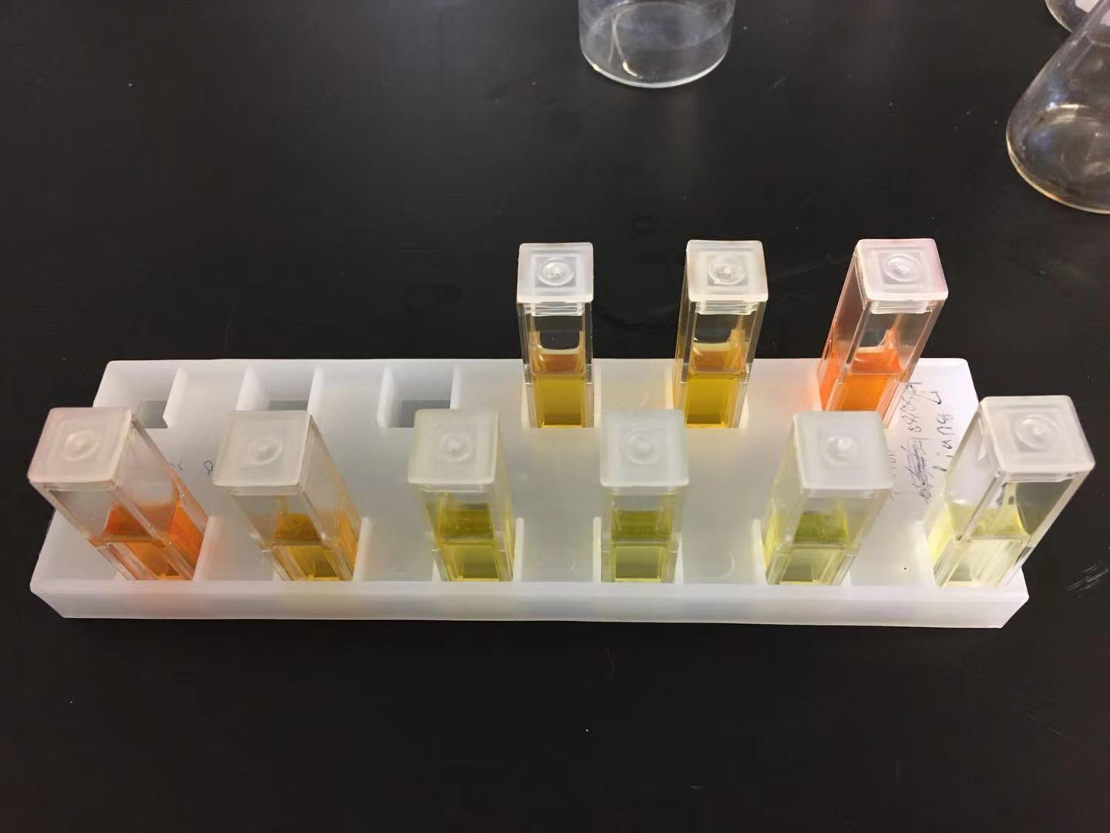
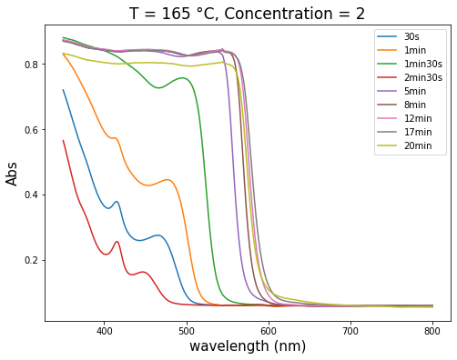
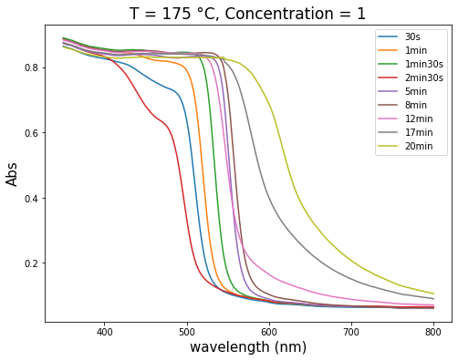
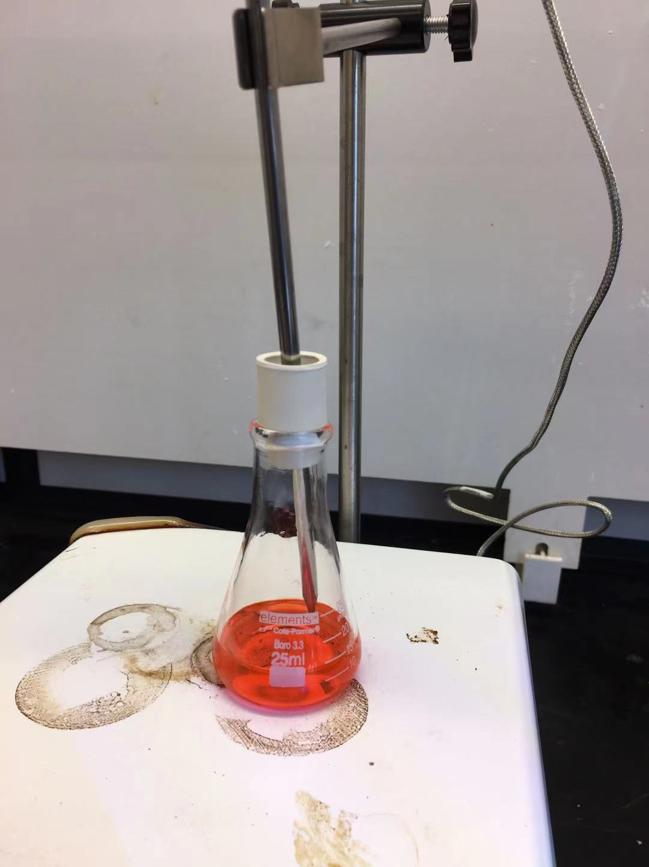
CdSe Quantum Dots
Liang Li, George Patrick Watson Singh Center for Nanotechnology, University of Pennsylvania
Introduction
Spectrum Analysis
Characterization
Larger QDs for circuit application
Emission Spectra
Quantum Dots (QDs) are particles or nanocrystals of semiconductive material
For CdSe QDs, the size are usually between 3 to 8 nm.
Aim to obtain larger QDs that can be used on devices.
QDs Extraction
Fig 1. QDs with different sizes^{[1]}
QDs in octadecene
Centrifuged in methanol and butanol
Centrifuged in acetone
QDs precipitated
QDs dissolved in hexane
Quantum Dots Synthesis
To obtain a microscopic image of QDs, an extraction process is needed.
After the extraction, QDs are dissolved in hexane solution for TEM imaging.
Prepare Selenium and Cadmium precursors.
Heat the reaction flask to desired temperature.
Inject both precursors simultaneously.
Quench QDs samples with different reaction time.
Absorption Spectra
Fig 2. QDs samples with different quench time
Fig 4. TEM image of QDs in hexane, taken by using JEOL 7500F TEM mode
Fig 5. TEM image of QDs in literature^{[3]}
Variables that may affect QDs size
Future work
Synthesis temperature
165 °C
175 °C
Precursor concentration
1 mL of both precursors.
2 mL of both precursors.
Quench time
Air (Oxidization)
Reaction exposed to air.
Reaction isolated from air.
Obtain TEM images of QDs with higher quality and resolution.
Deposit QDs on Si substrate and make a two-terminal device.
Make three-terminal device and circuit applications.
Higher precursor concentration leads to larger QDs (larger emission wavelength).
Reaction temperature only affects the reaction speed.
Longer quench time result in larger QDs in a certain time window, but after a certain threshold, QDs start to turn bad as the quench time become longer.
Reaction isolated from air leads to larger QDs and maintain sharp emission peaks.
References
[1] Matthew L. Landry et al. Simple Syntheses of CdSe Quantum Dots. J. Chem. Educ. 2014, 91, 274−279
[2] Elizabeth M. Boatman et al. A Safer, Easier, Faster Synthesis for CdSe Quantum Dot Nanocrystals. J. Chem. Educ. 2005, Vol 82, No.11
[3] C. B. Murray et al. Synthesis and characterization of nearly monodisperse CdE (E = sulfur, selenium, tellurium) semiconductor nanocrystallites. Journal of the American Chemical Society 1993 115 (19), 8706-8715
[4] Z. Adam Peng et al. Formation of High-Quality CdTe, CdSe, and CdS Nanocrystals Using CdO as Precursor. J. Am. Chem. Soc. 2001, 123, 183-184
Fig 3. QDs synthesis flask with a cork that isolate the air contact.

